Slide 1
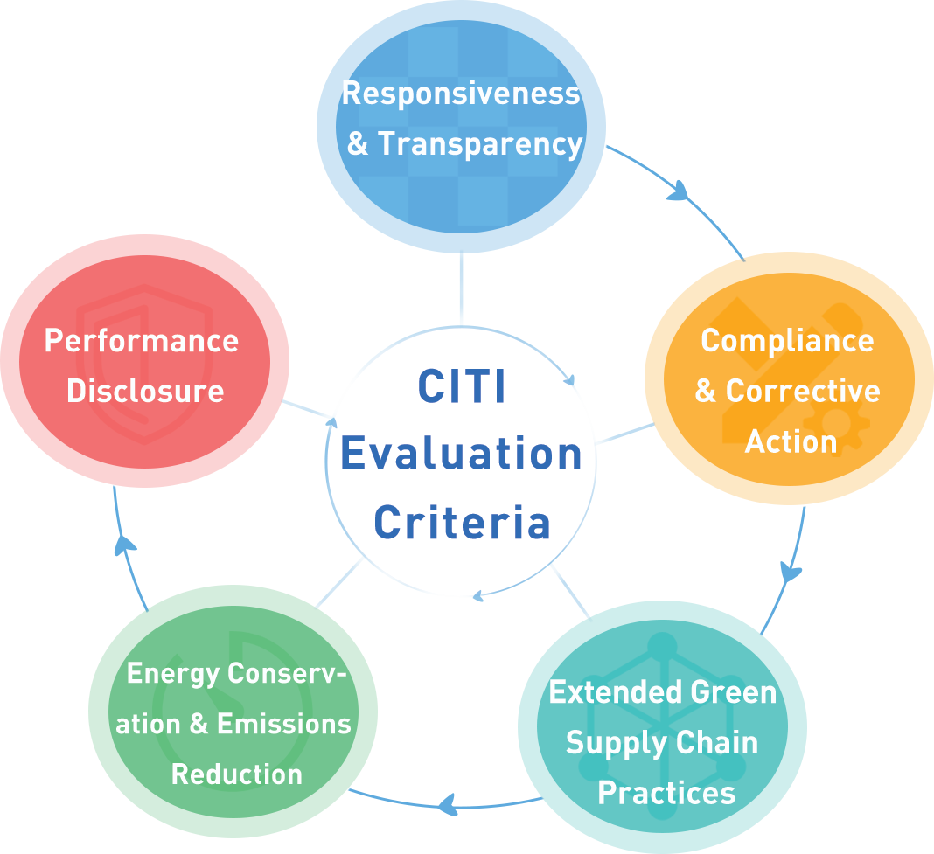
Green Supply Chain CITI Evaluation
Developed jointly by the Institute of Public & Environmental Affairs (IPE) and the Natural Resources Defense Council (NRDC) in 2014. Focusing exclusively on supply chain impacts, where the greatest environmental impacts and carbon hotspots lie, the CITI evaluation provides an important complement to broader global sustainability initiatives and reporting indices developed for the private sector.
Key Performance Indicators:
Companies leverage environmental data to improve supply chain management efficiency, comprehensively manage environmental risks and promote environmental compliance along the supply chain in China.
Companies extend environmental and carbon management to energy-intensive and emission-intensive suppliers.
Companies leverage digital tools to drive suppliers to account for and disclose environmental and carbon data, leading to continuous improvement beyond compliance requirements.
Companies guide and motivate suppliers to manage the environmental performance and GHG emissions of their supply chains, accelerating industry transformation.
Companies actively communicate with stakeholders and build trust via information disclosure, continuously improving the transparency and credibility of supply chain environmental management.

Slide 2
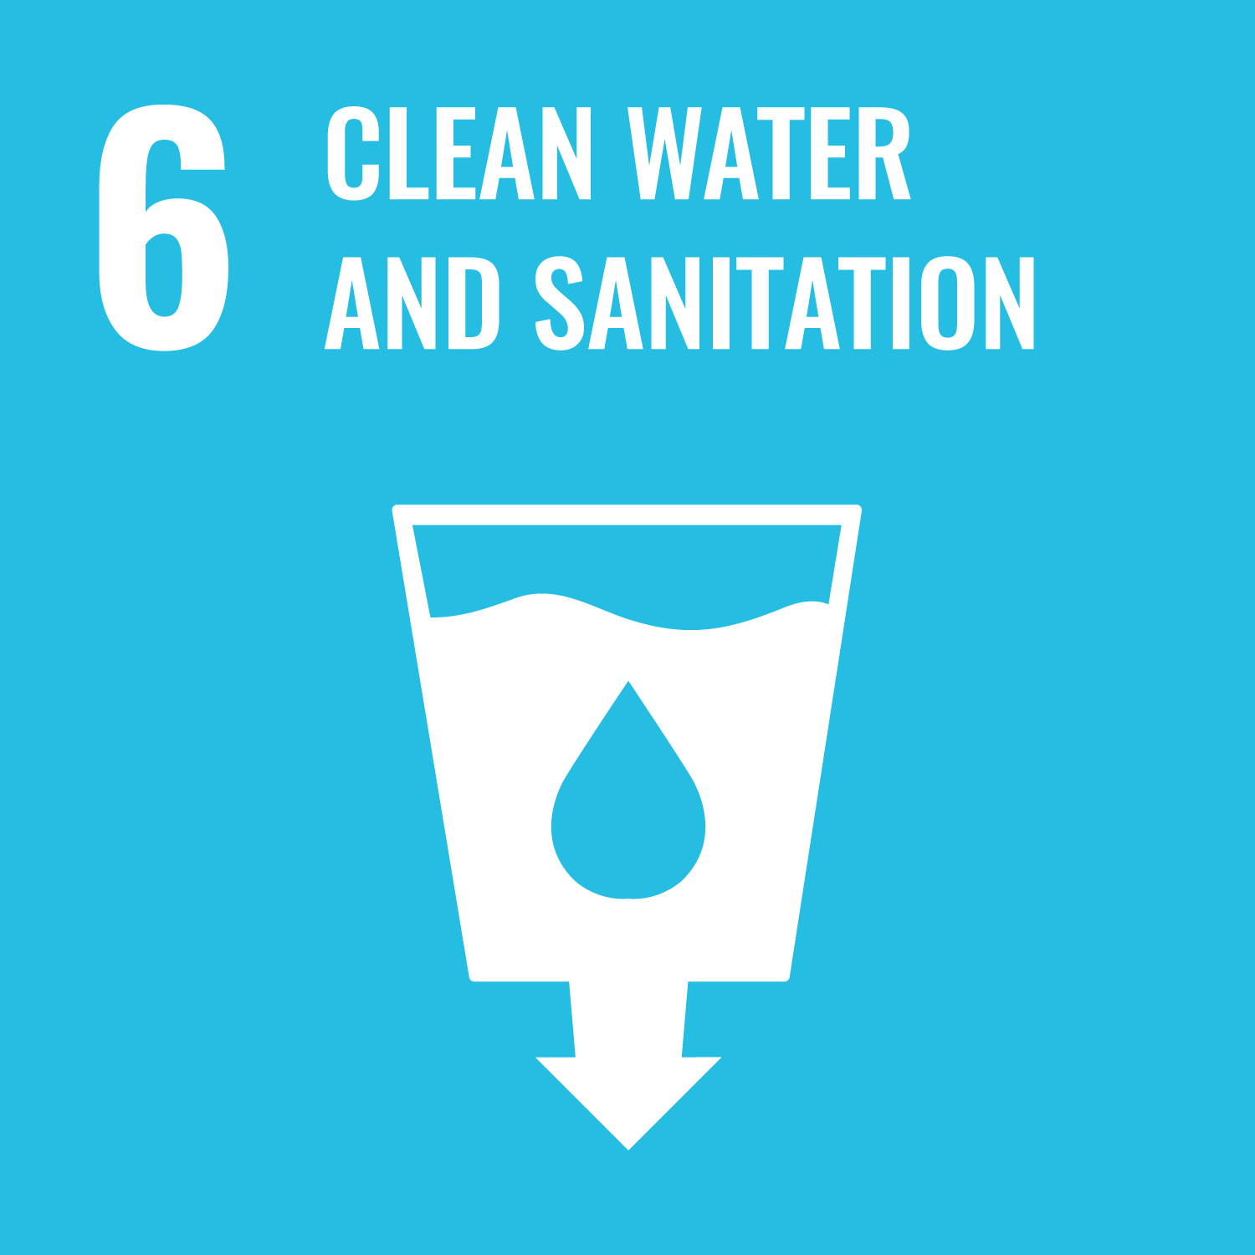
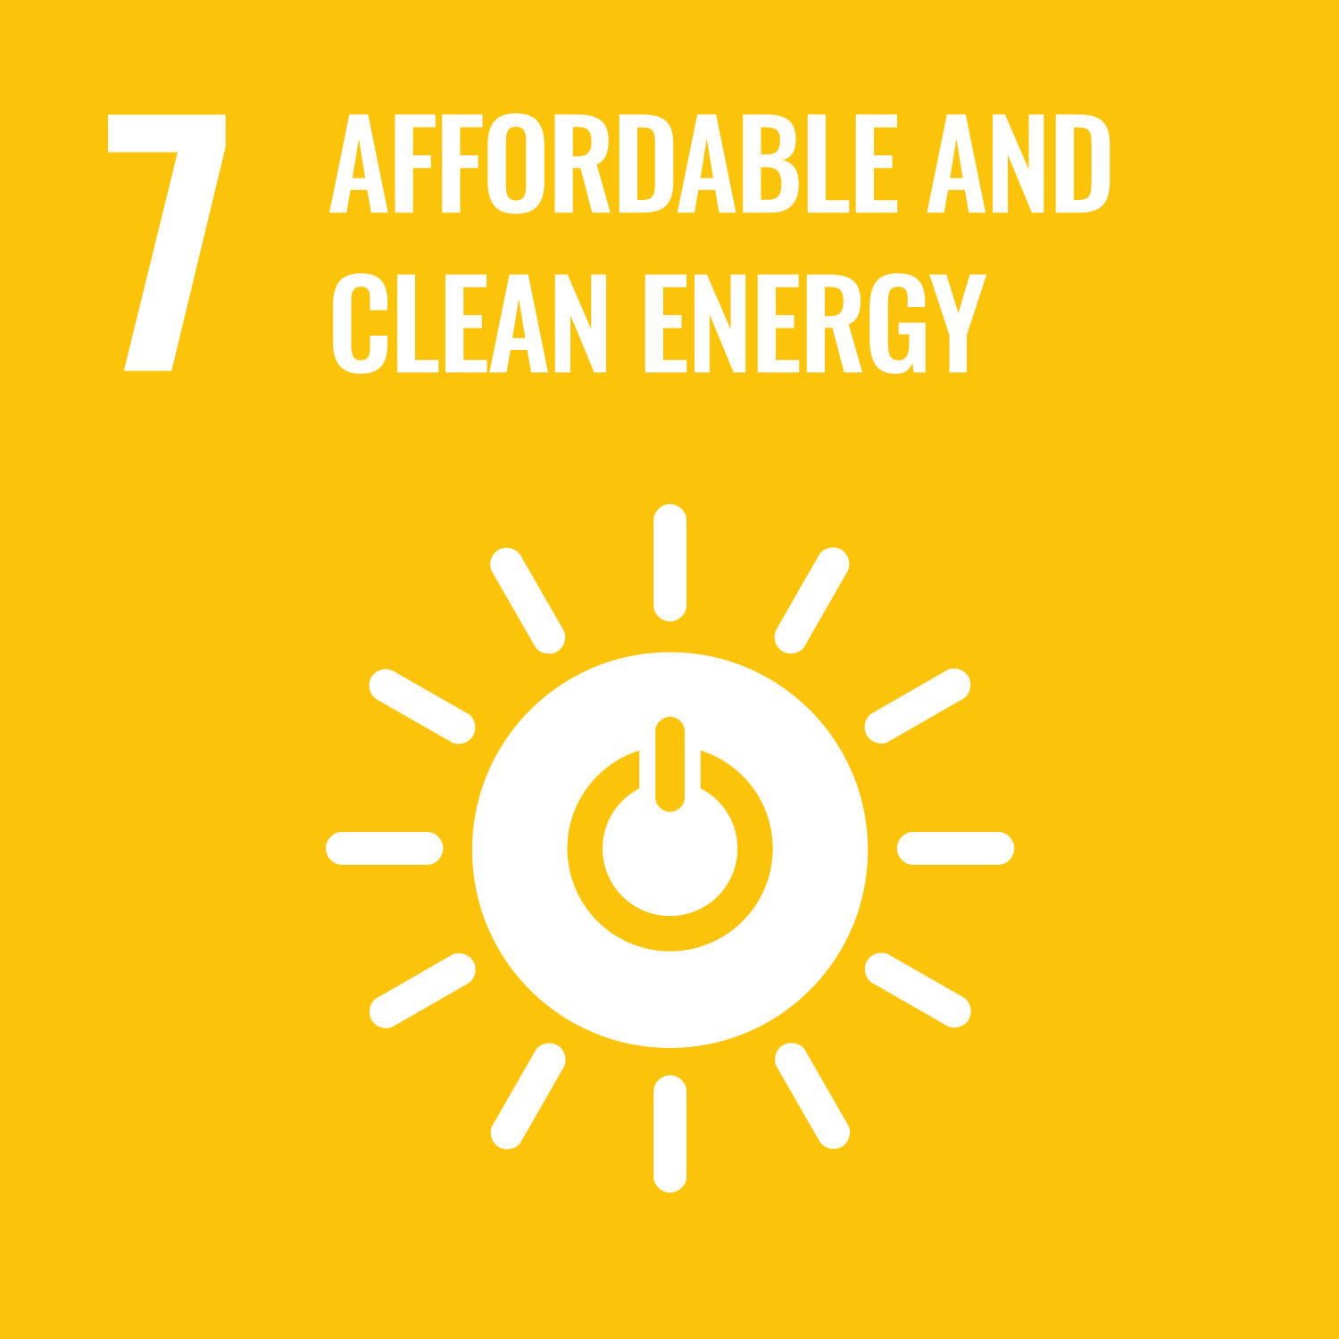
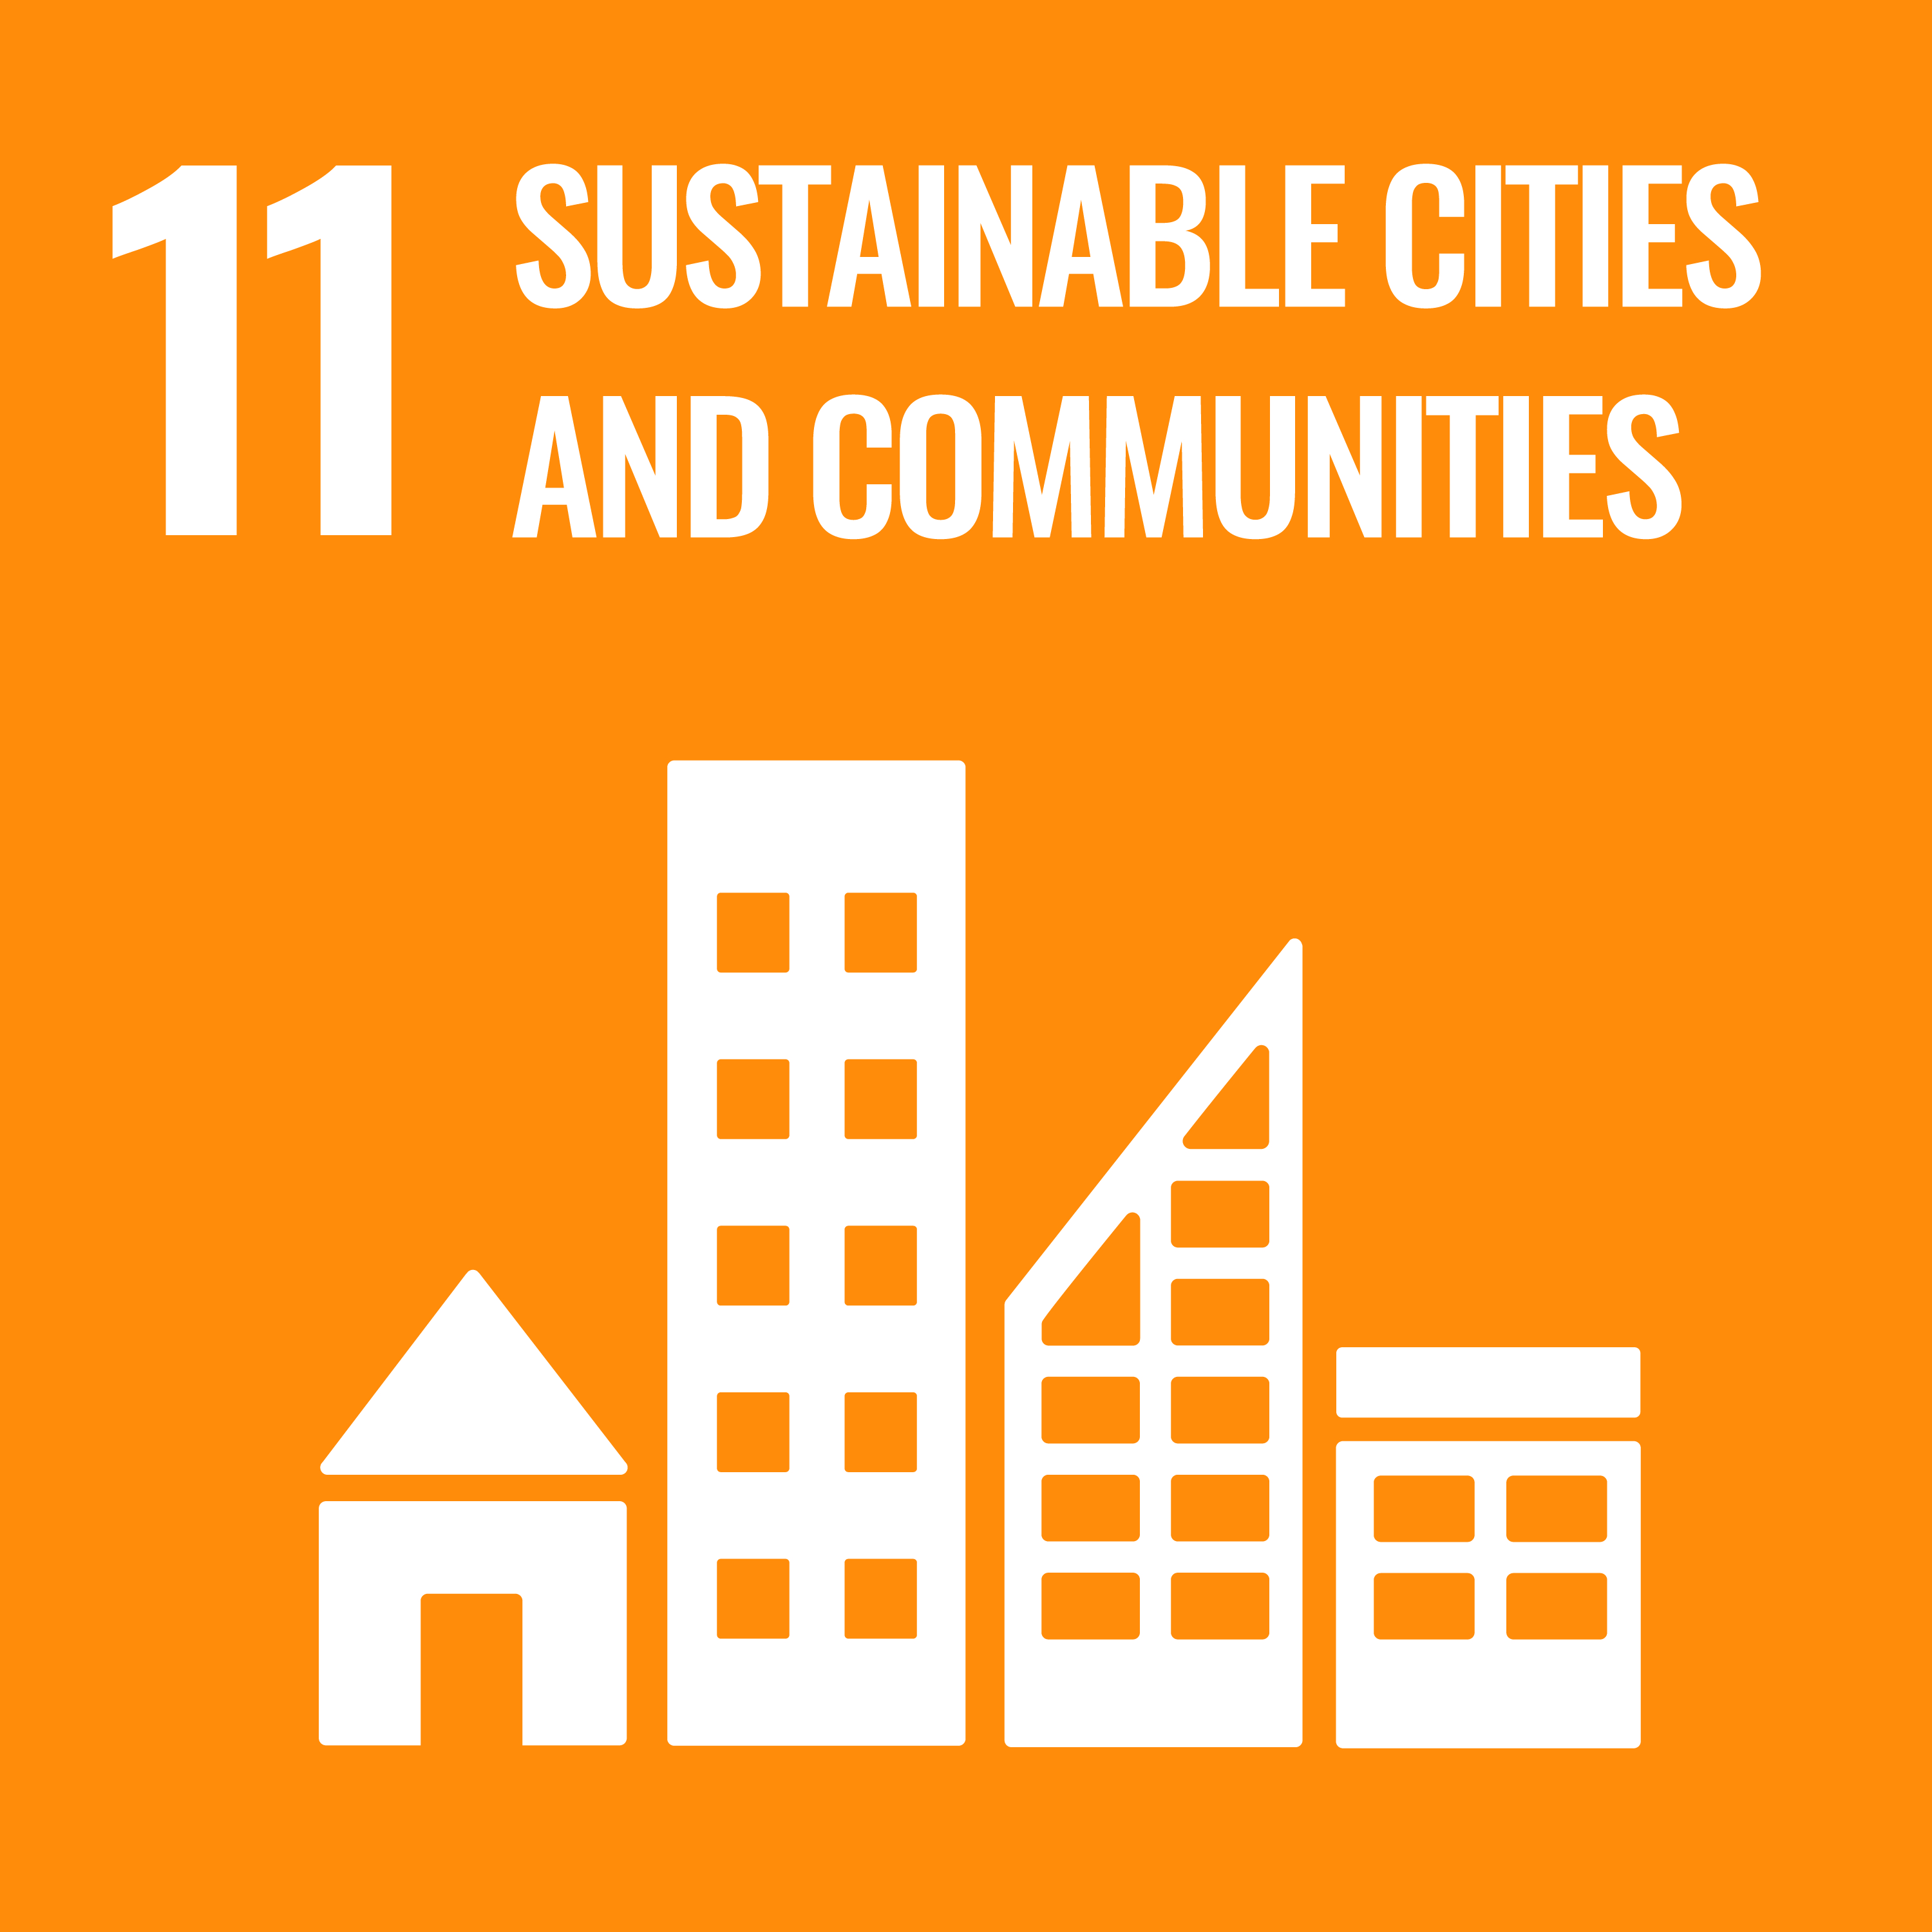
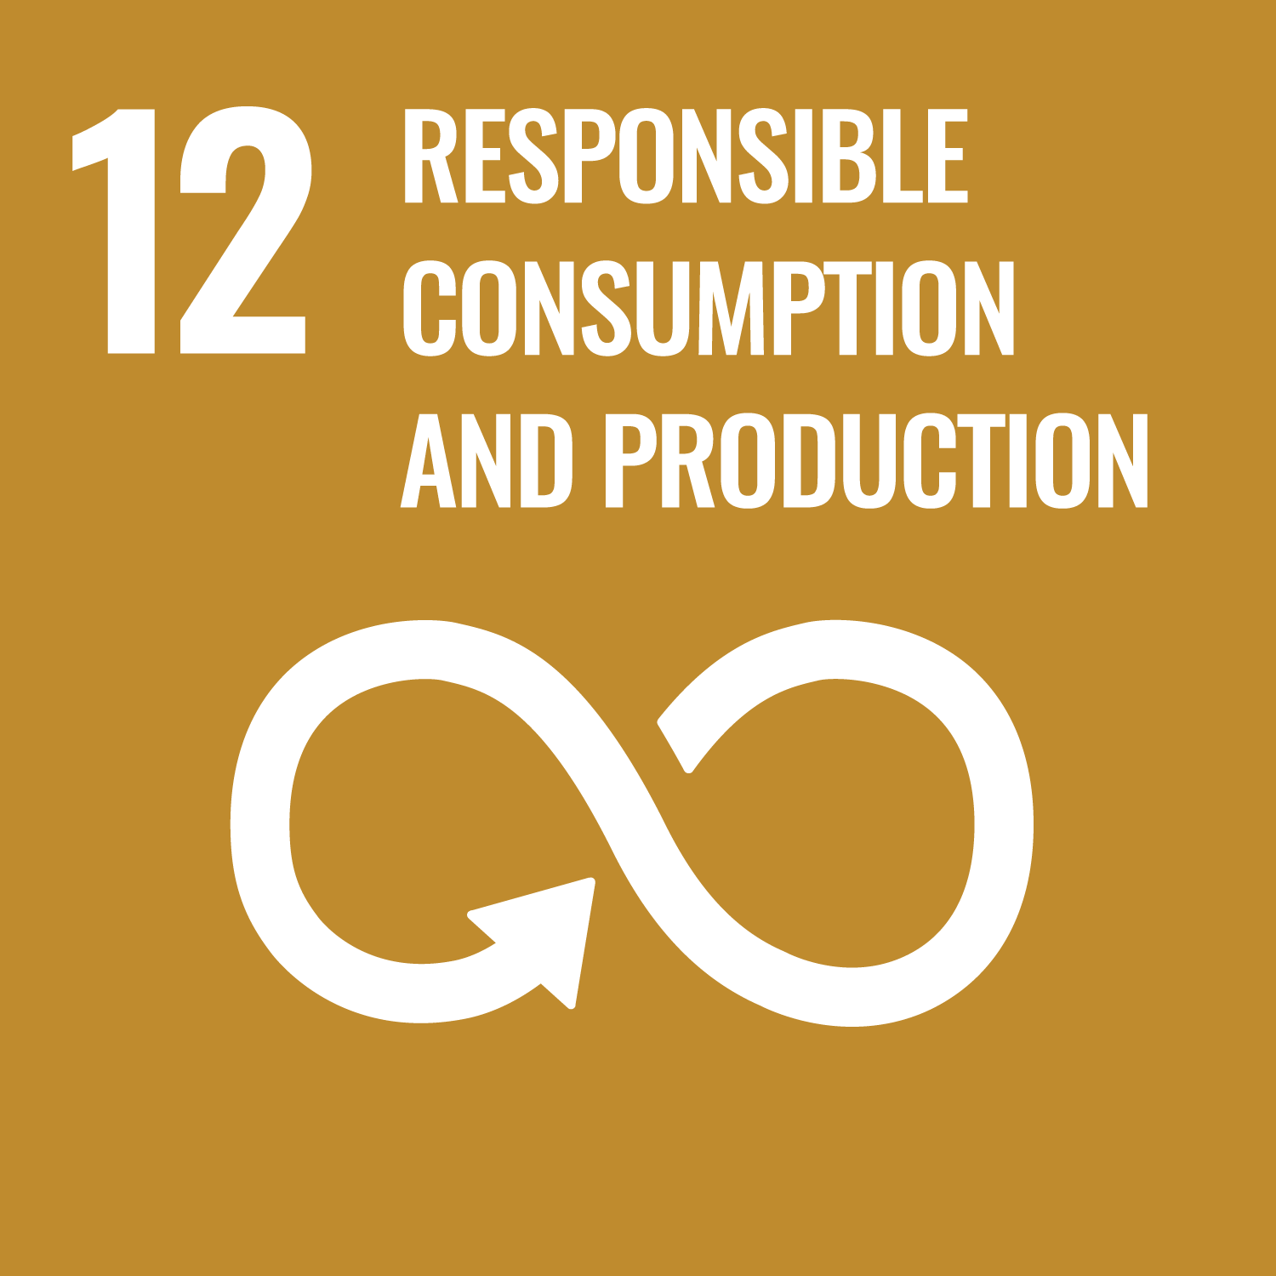
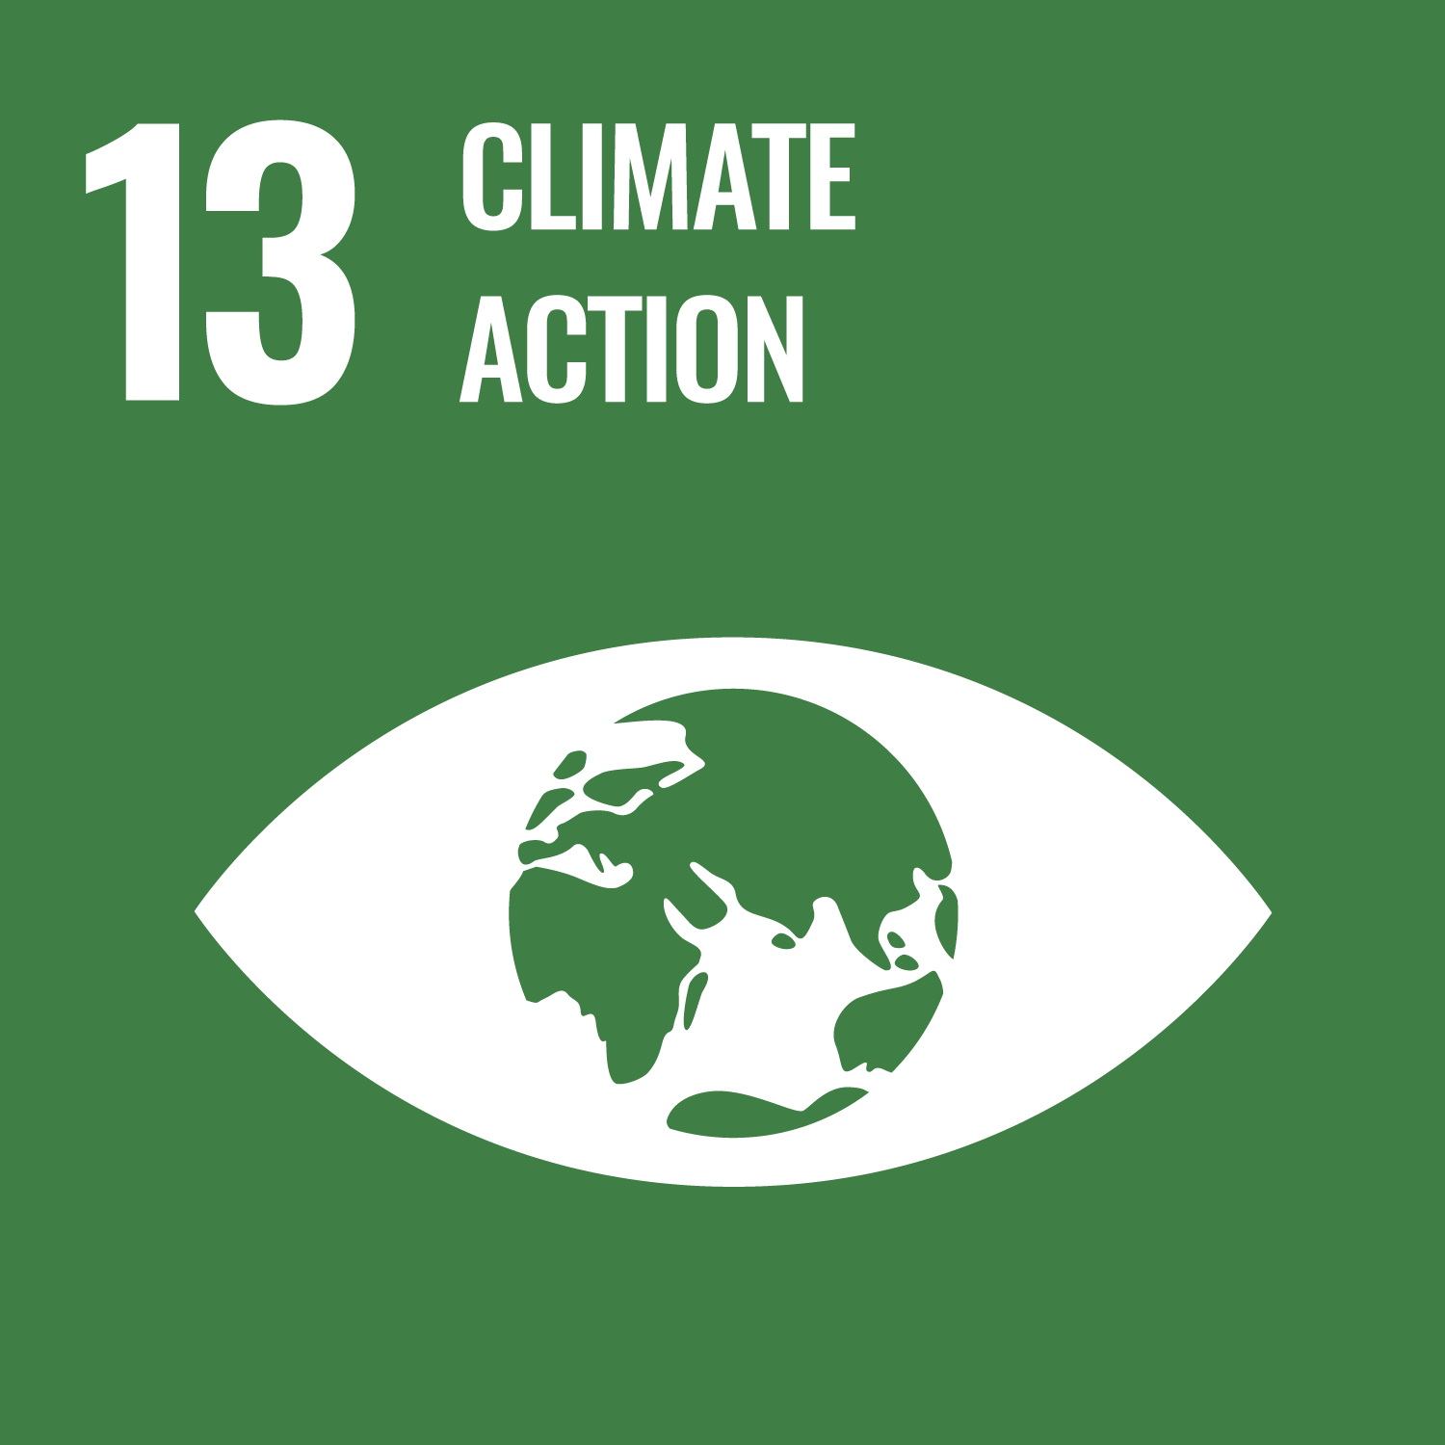
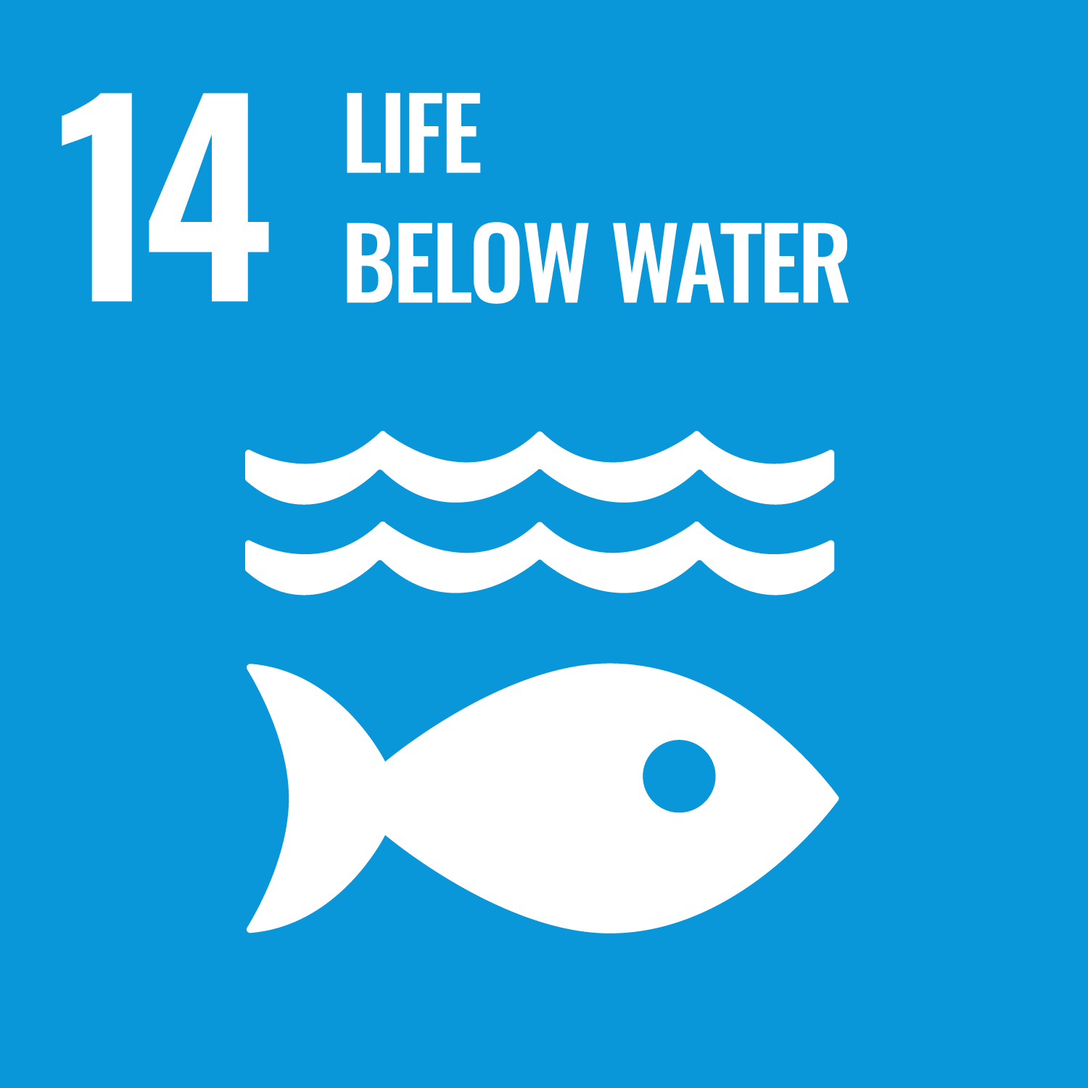
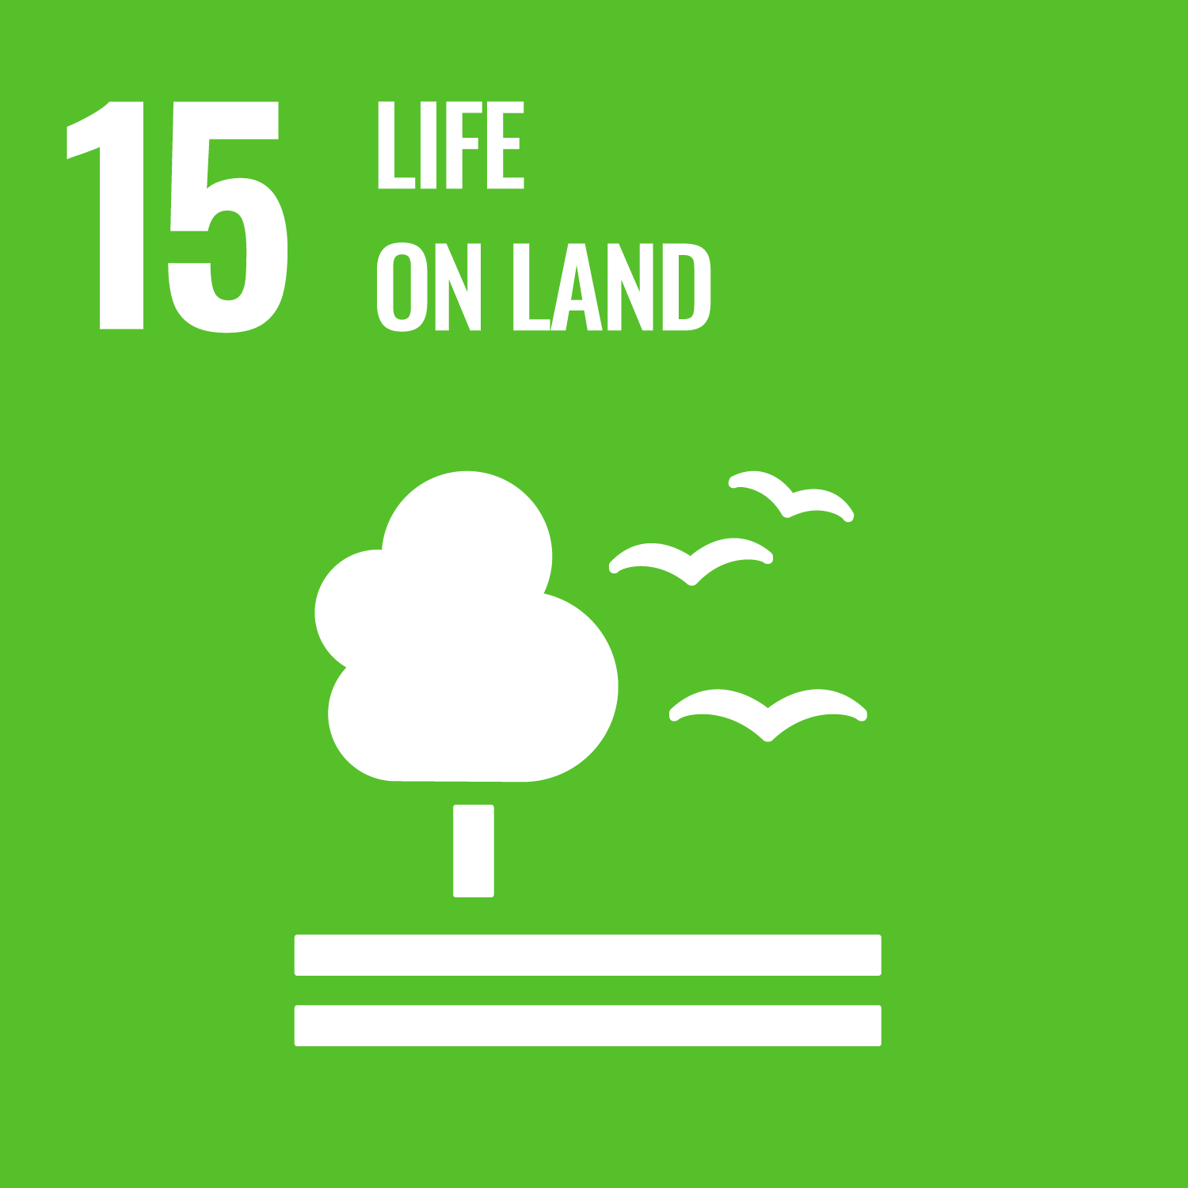
CITI Aligned with:
China’s policies and standards, including:
Opinions of the Supreme People‘s Court on Completely, Accurately, and Comprehensively Implementing the New Development Philosophy and Providing Judicial Services for Actively and Steadily Promoting Carbon Peak and Carbon Neutrality (SPC,2023)
Implementation Plan for Synergizing Reduction of Pollution and Carbon Emission (MEE and 6 other Ministries, 2022 )
Outline of the 14th Five-Year Plan for Economic and Social Development (2021–2025) and Long-Range Objectives through the Year 2035
Circular on further Promoting the Nationwide Battle to Prevent and Control Pollution (CPC Central Committee, State Council, 2021)
The 14th Five-Year Comprehensive Work Plan for Energy Conservation and Emission Reduction (State Council, 2021)
The 14th Five-Year Plan for Developing Circular Economy (NDRC, 2021)
The 14th Five-Year Action Plan on Plastic Pollution Control (NDRC, MEE, 2021)
The 14th Five-Year Plan on Green Development of the Industrial Sector (MIIT, 2021)
Guiding Opinions on Coordinating and Strengthening the Work related to Climate Change and Ecological Environmental Protection (MEE, 2021)
Measures for the Administration of Legal Disclosure of Enterprise Environmental Information (MEE, 2021)
GB/T 33635-2017 Green Manufacturing - Green Supply Chain Management in Manufacturing Enterprises – Guidelines, and related standards
GRI Standards
GRI 102: General Disclosures GRI 302: Energy GRI 303: Water and Effluents GRI 305: Emissions
GRI 306: Waste
GRI 307: Environmental Compliance
GRI 308: Supplier Environmental Assessment
Standards for the Contents and Formats of Information Disclosure by Companies Offering Securities to the Public (China Securities Regulatory Commission)
The Environmental, Social and Governance Reporting Guide (Hong Kong Exchanges and Clearing Limited)
Corporate Sustainability Reporting Directive (CSRD) (EU)
Proposal for a Directive on Corporate Sustainability Due Diligence and Annex (EU)

Slide 3
FAQ:
Who does CITI evaluate?
CITI primarily evaluates consumer-facing companies that have a sizeable supply chain in China.
What benefits does CITI evaluation bring?
CITI is structured to provide a step-by-step roadmap for the private sector to improve their sourcing programs and incorporate environmental performance and carbon footprints into the selection of manufacturers for their goods.
What is the connection between CATI and CITI evaluations?
The total score of a company’s Corporate Climate Action Transparency Index (CATI) evaluation is converted by a factor of 20% into a score for CITI Indicator 4.1.
Where can I find the CITI evaluation results?
The results are available on the IPE website and the Blue Map APP.
Read the 2014, 2015, 2016, 2017, 2018, 2019, 2020, 2021, 2022 and 2023 CITI reports.
How can companies join the CITI evaluation?
Email us at gsc@ipe.org.cn.
What is the frequency and process of the CITI evaluation?
The evaluation is conducted on a DYNAMIC basis.
At the beginning of each year, IPE updates the CITI evaluation guidelines and publishes a report towards the end of the year, illustrating the progress and gaps in the evaluation.
Prior to the publication of the annual evaluation report, IPE will attempt to inform the corporations of the preliminary results and provide the opportunity to review the evaluation results.
What is the basis of the CITI evaluation?
The information used for evaluation was obtained from official websites of corporations; annual reports, corporate social responsibility (CSR) reports, environmental, social, and governance (ESG) reports, and other regular reports; information released in public channels, such as on official websites; data released by credible sources collected by the Blue Map database; and responses to CDP climate change questionnaires publicly disclosed by companies.

Slide 4
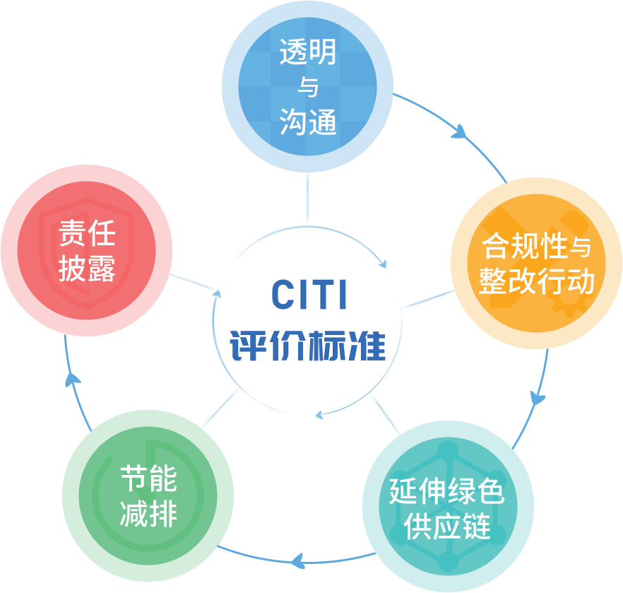
绿色供应链CITI指数
绿色供应链CITI指数由公众环境研究中心（IPE）和自然资源保护协会（Natural Resources Defense Council，NRDC）于2014年合作研发。
CITI指数重点关注供应链，特别是生产环节对环境的影响，是全球可持续发展议程和主流机制的有益补充 。
获得高分的关键在于：
借助环境大数据提升管理效率，更全面的管控在华供应链环境风险，推动在华供应商实现环境合规；
以产品生命周期环境合规为目标，向供应链更加上游的高耗能、高排放环节延伸环境和碳管理；
借助数字化工具，推动供应商核算并公开披露环境和碳数据，形成超越合规要求的持续改进；
引导和激励供应商管控自身供应链的环境表现和温室气体排放，带动产业链加速绿色低碳转型；
积极与利益方沟通交流，通过充分的信息公开构建信任，不断提升供应链管理的透明度和可信度。

Slide 5
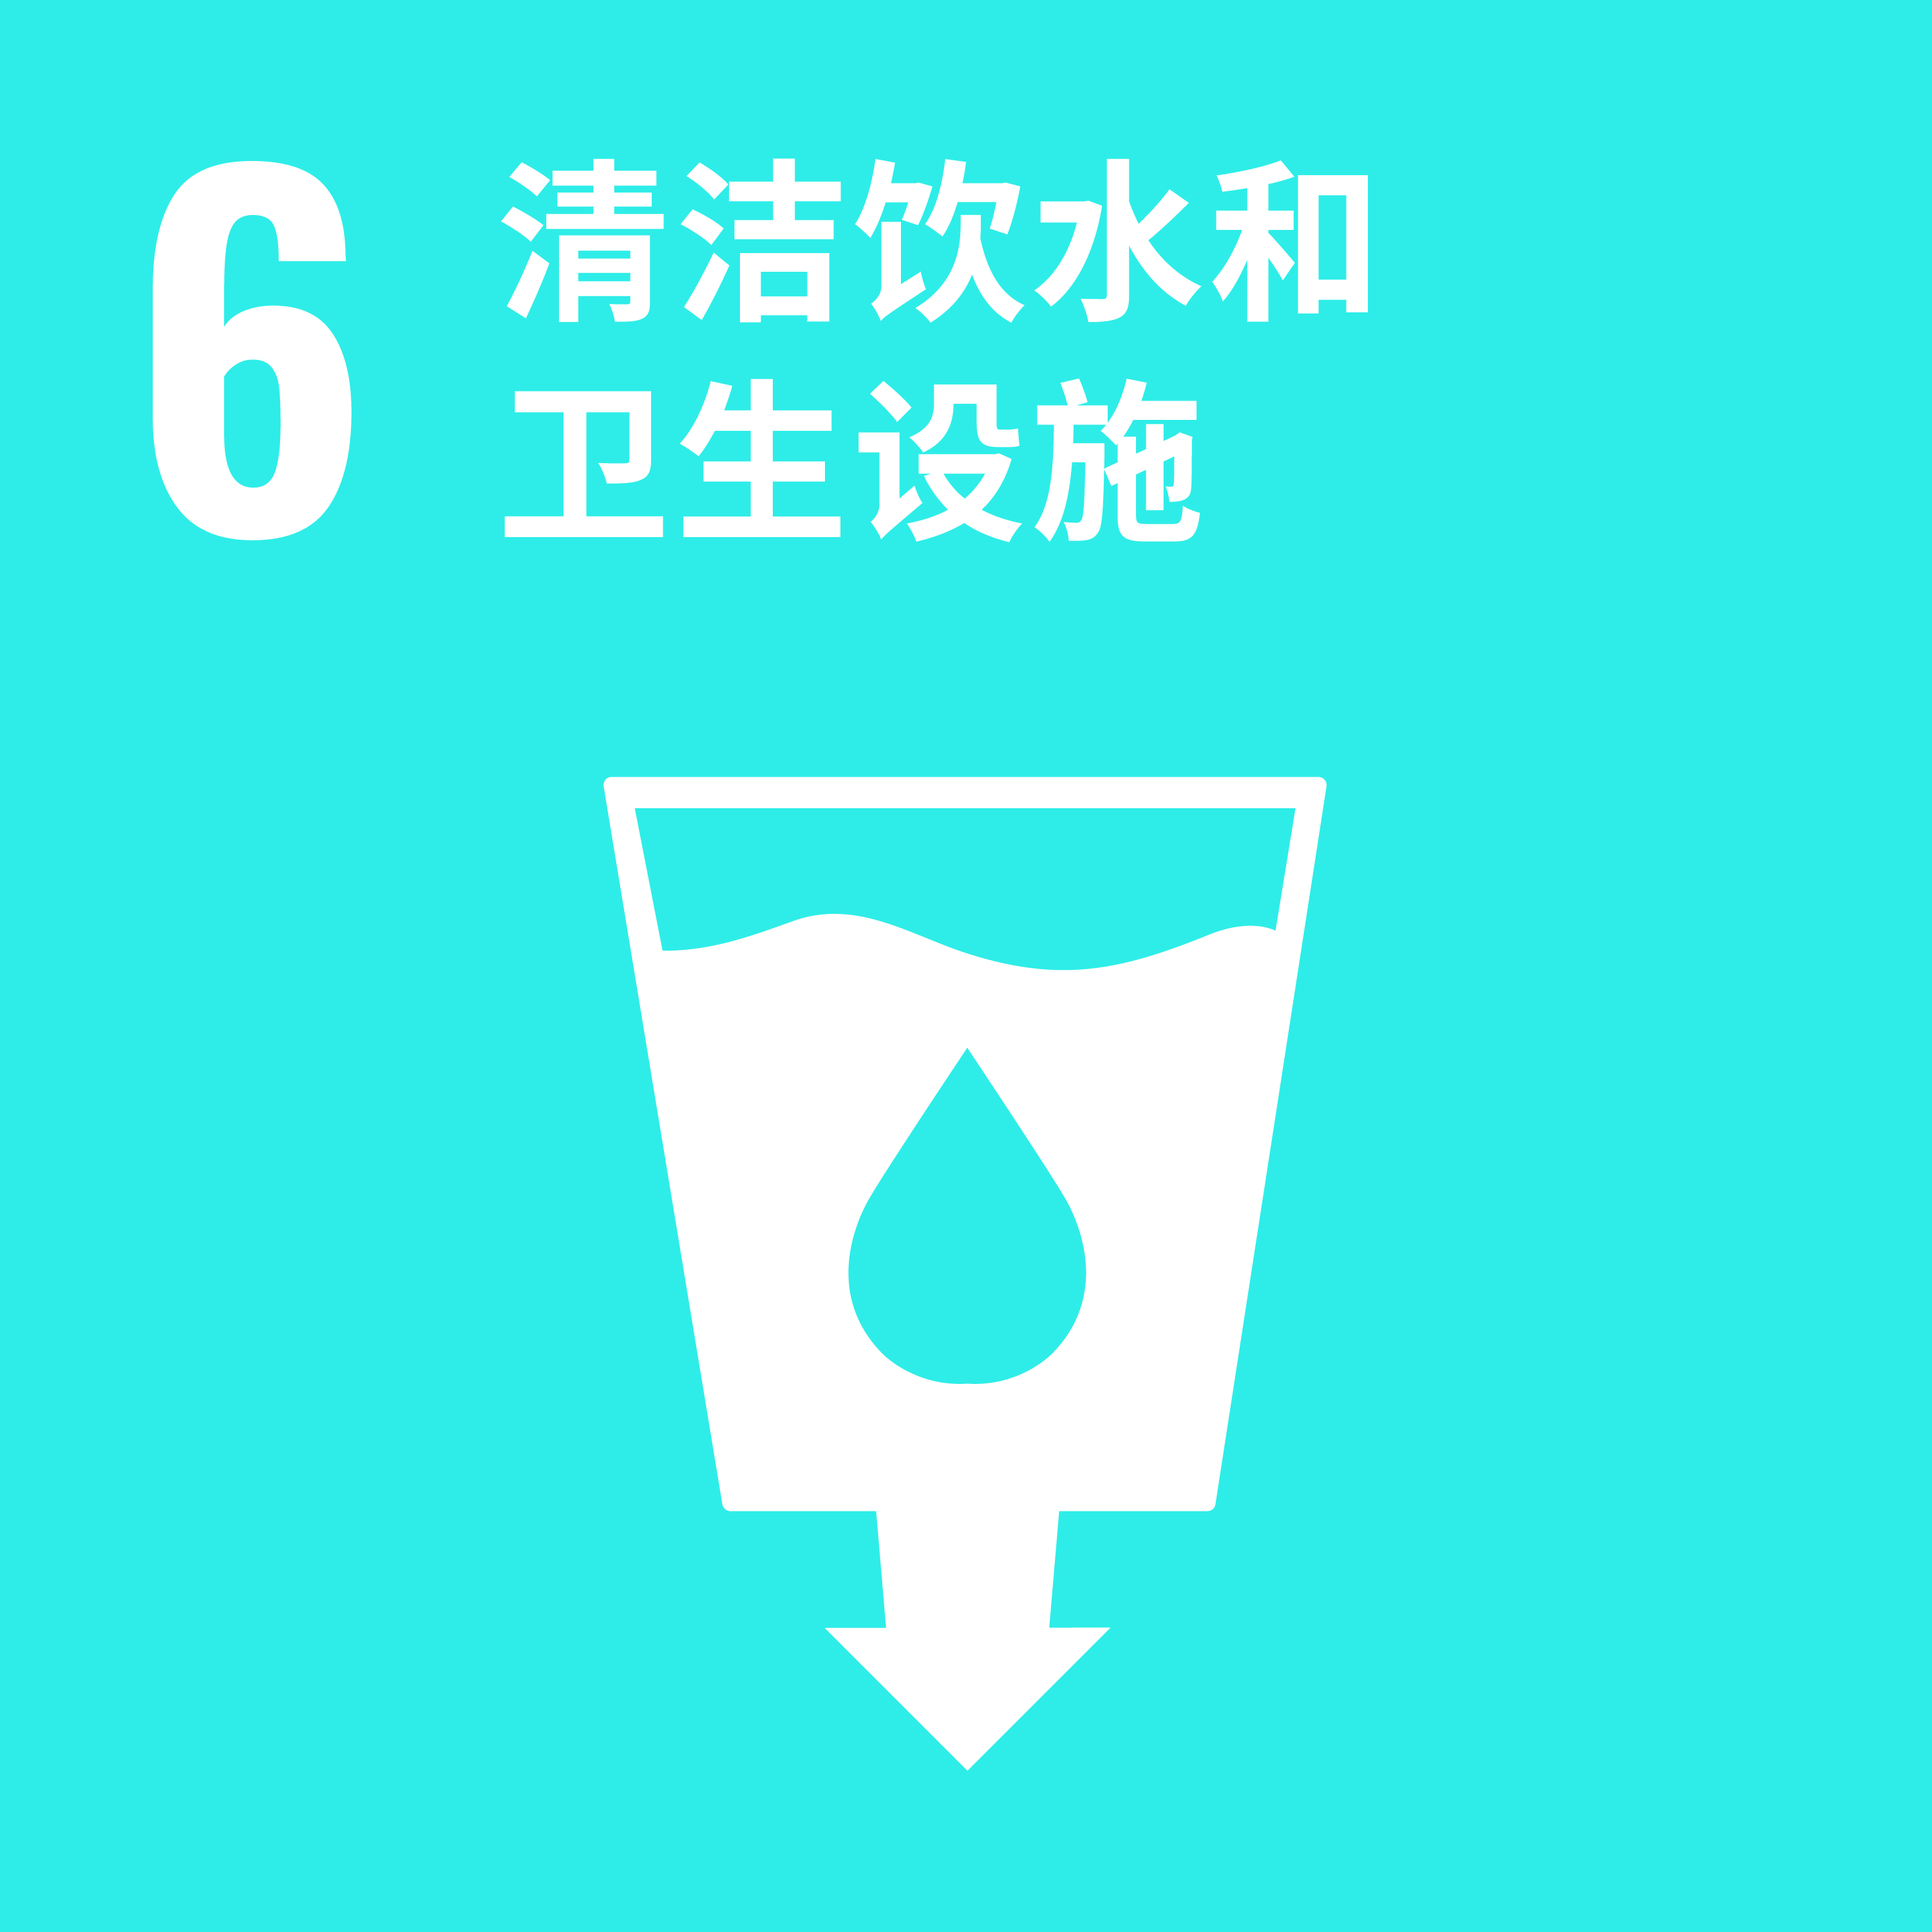
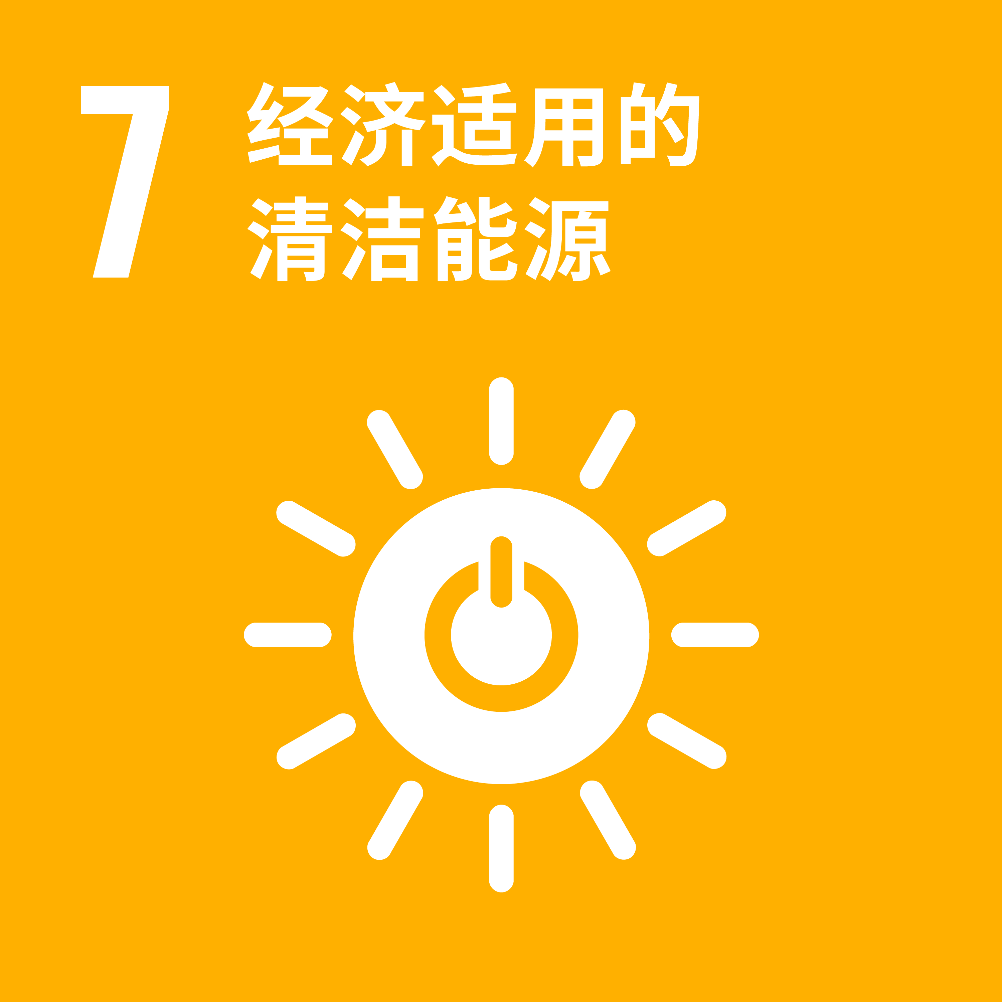
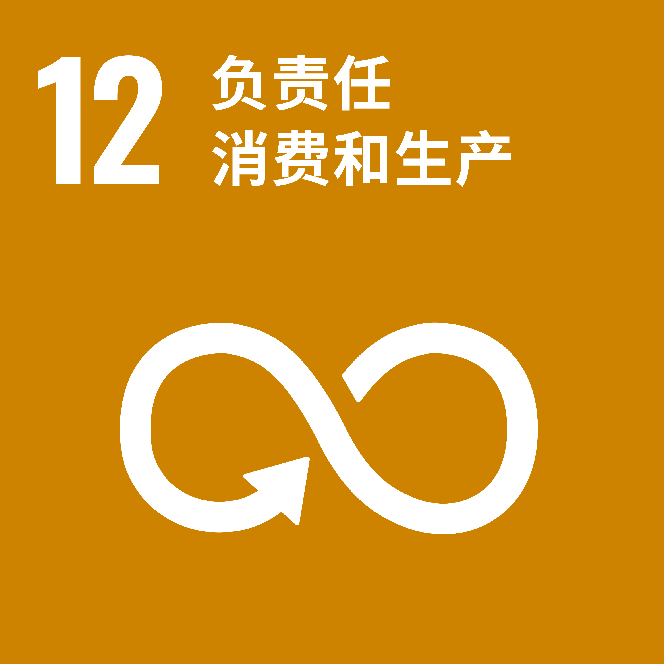
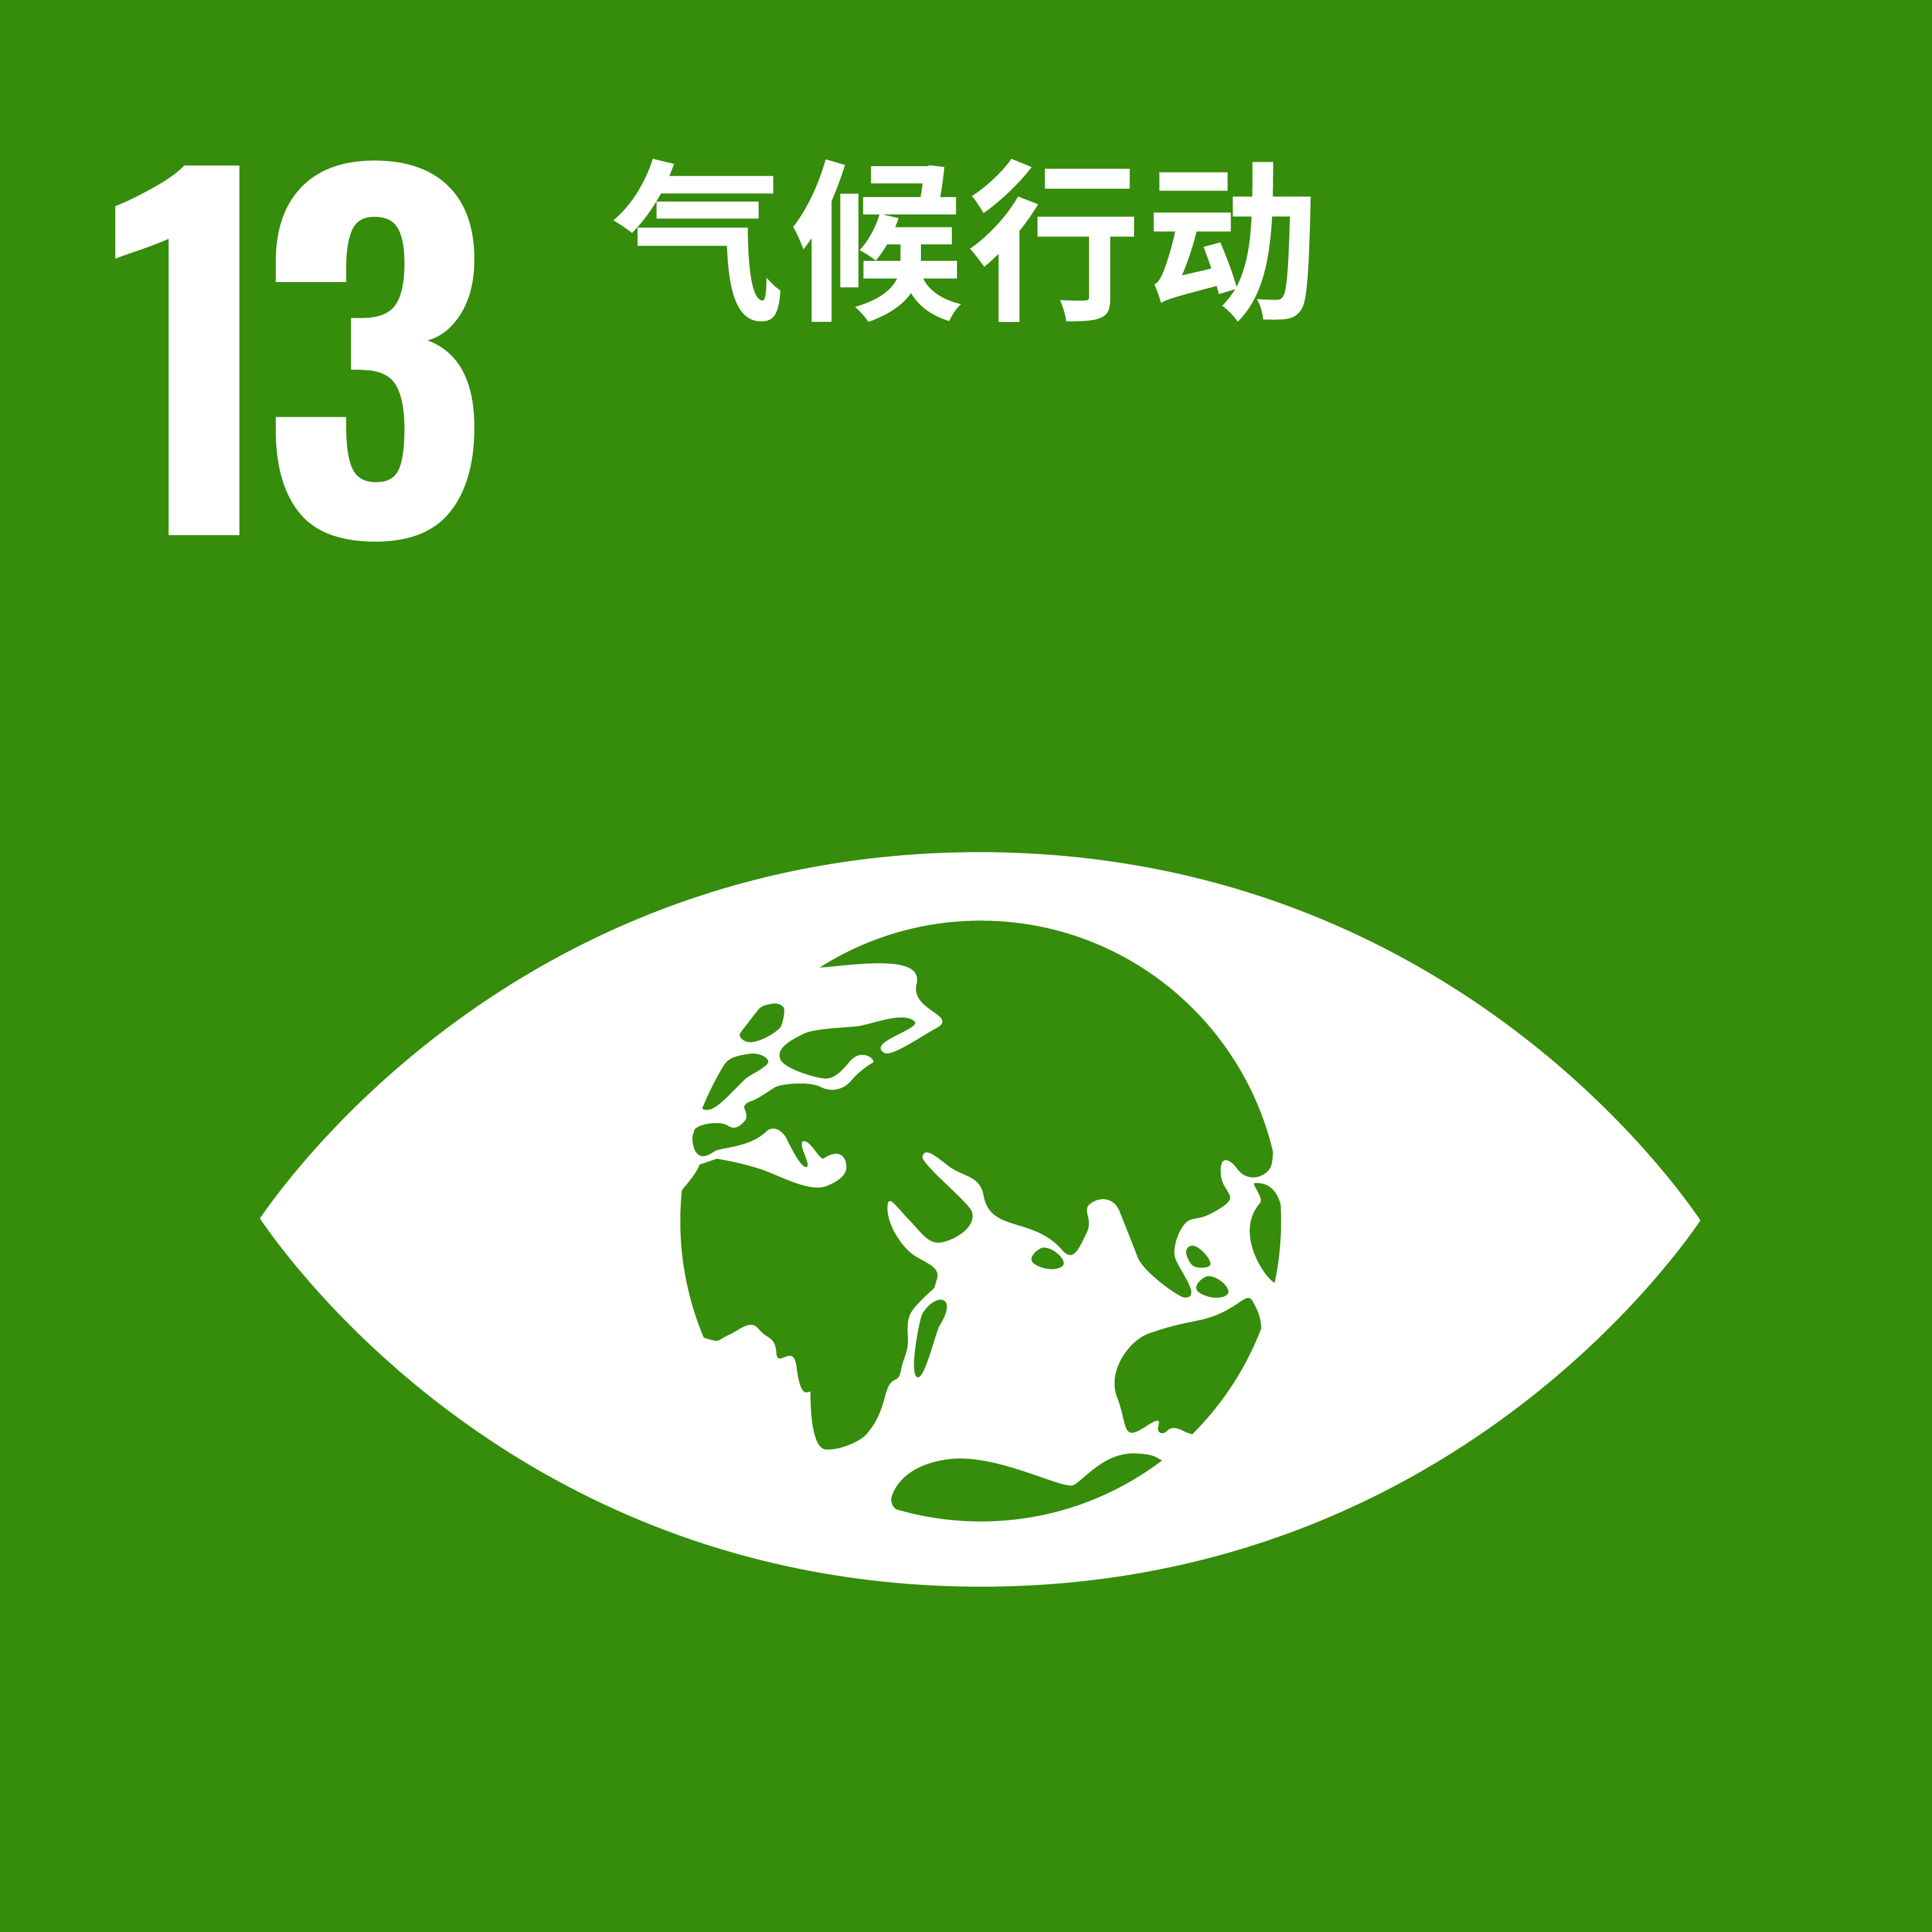
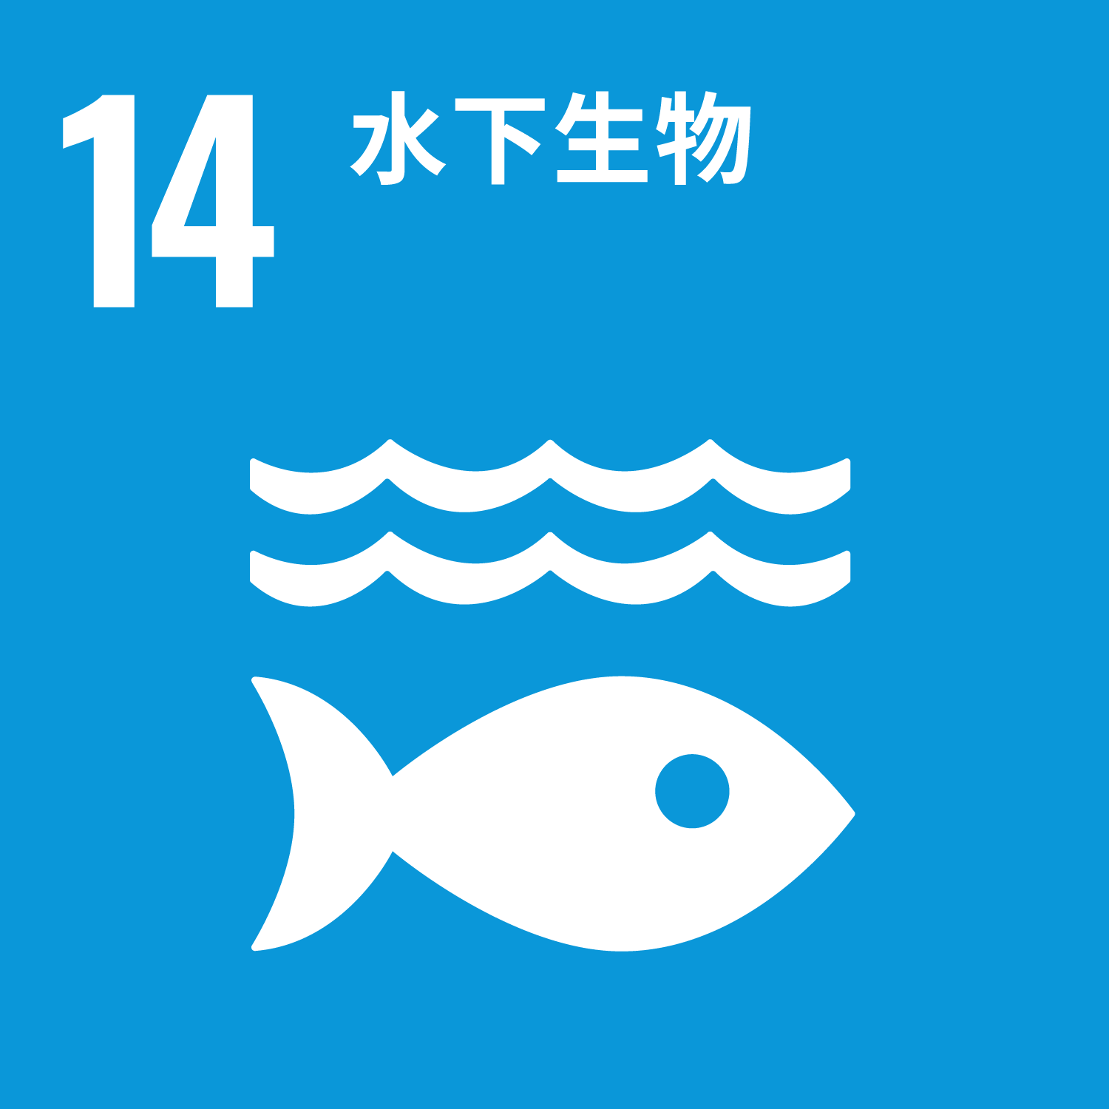
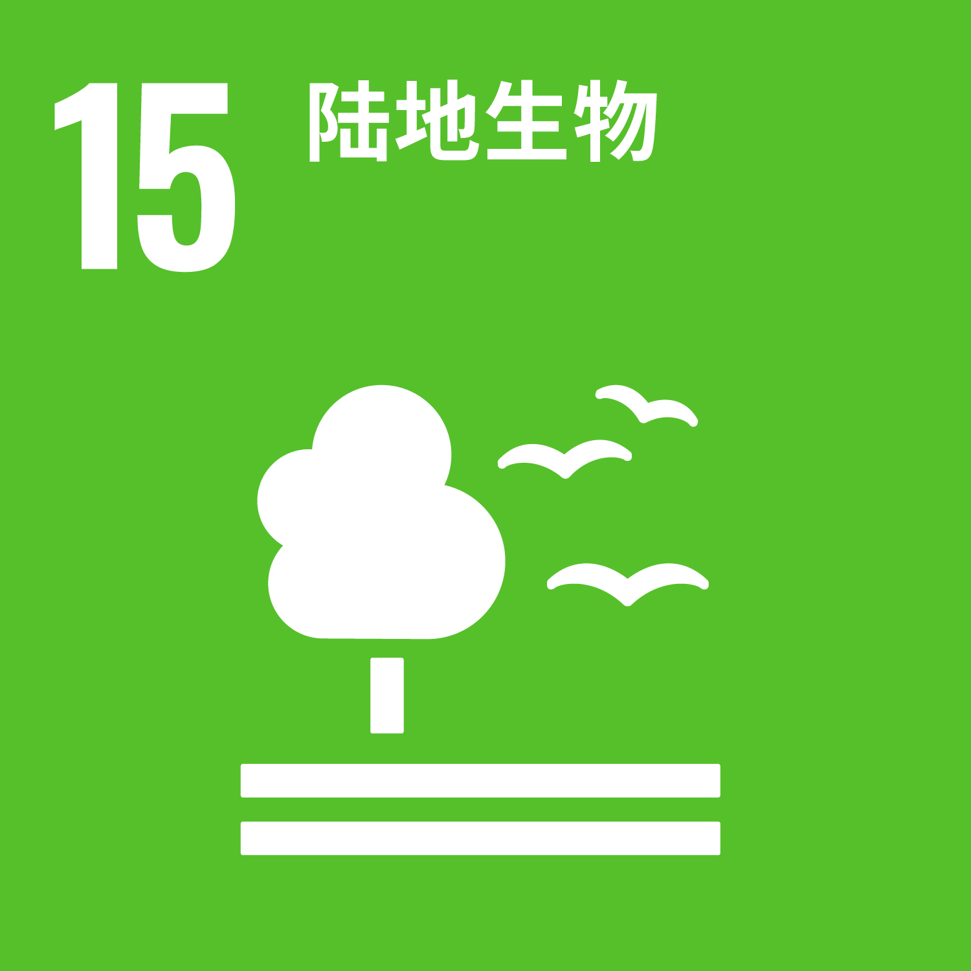
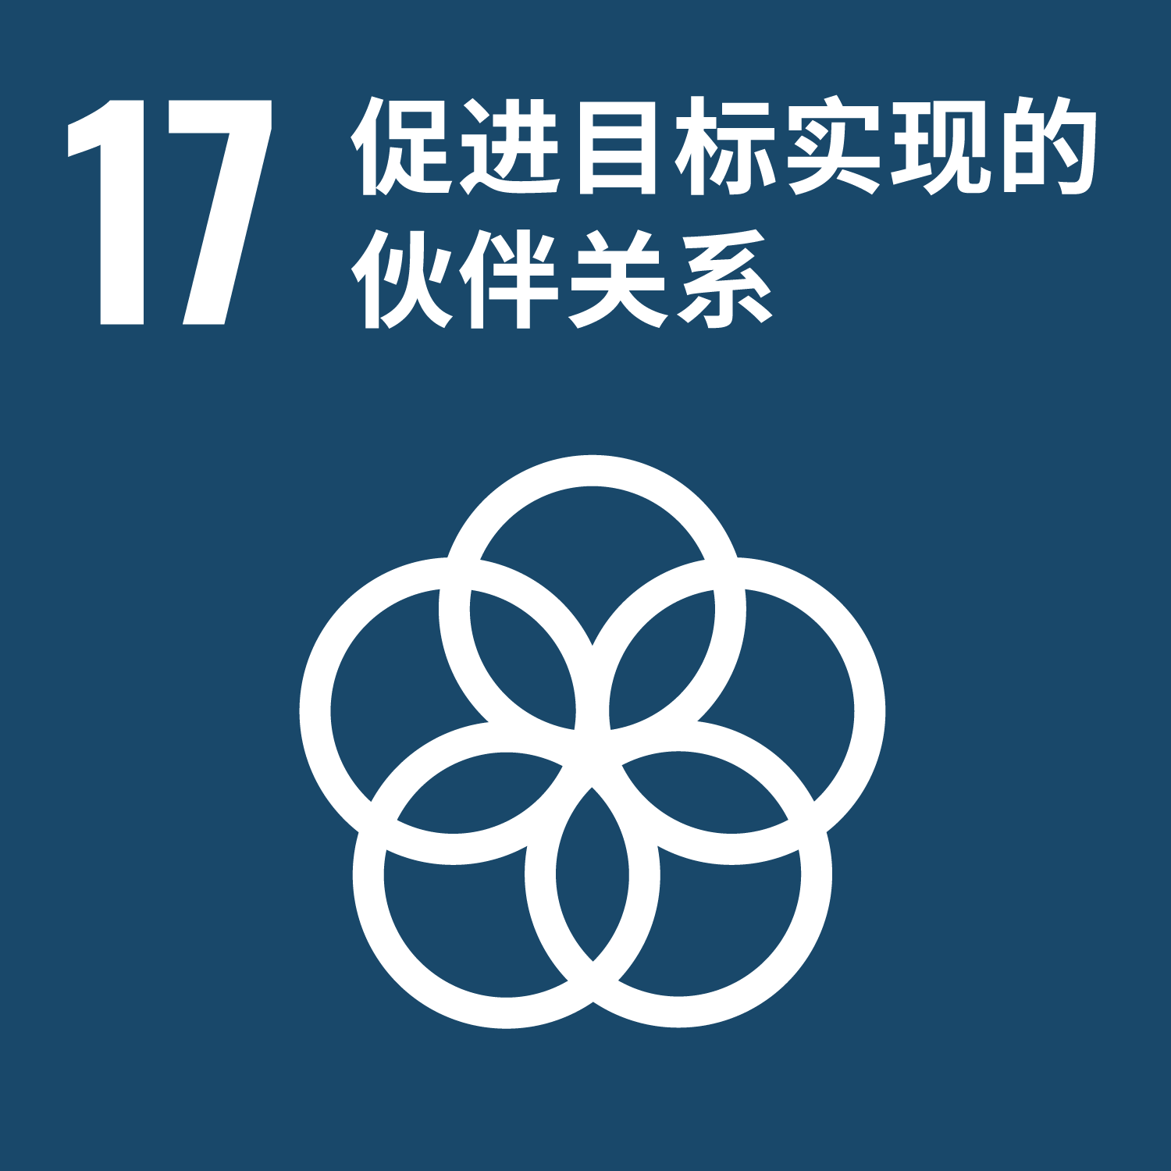
绿色供应链CITI指数对标：
中国政府政策要求和国家标准，包括:
《最高人民法院关于完整准确全面贯彻新发展理念 为积极稳妥推进碳达峰碳中和提供司法服务的意见》（最高人民法院，2023）
《减污降碳协同增效实施方案》（生态环境部等7部委，2022年6月）
《国民经济和社会发展第十四个五年规划和2035年远景目标纲要》
《关于深入打好污染防治攻坚战的意见》（中共中央 国务院，2021 ）
《“十四五”节能减排综合工作方案》（国务院，2021）
《“十四五”循环经济发展规划》（发改委，2021）
《“十四五”塑料污染治理行动方案》（发改委 生态环境部，2021）
《“十四五”工业绿色发展规划》（工信部，2021）
《关于统筹和加强应对气候变化与生态环境保护相关工作的指导意见 》（生态环境部，2021）
《企业环境信息依法披露管理办法》（生态环境部，2021）
GB/T 33635-2017《绿色制造 制造企业绿色供应链管理 导则》
及配套的绿色供应链管理标准
GRI标准
GRI 102: 一般性披露 GRI 302: 能源 GRI 303: 水和污水
GRI 305: 排放
GRI 306: 废物处置
GRI 307: 环境合规
GRI 308: 供应商环境评价
中国证券监督管理委员会
《公开发行证券的公司信息披露内容与格式准则》
香港交易所《環境、社會及管治報告指引》
欧盟《Corporate Sustainability Reporting Directive》 、 《关于企业可持续发展尽职调查指令草案》

Slide 6
常见问题：
CITI的评价对象是谁？
主要是直接面向消费者，且在中国具有一定规模供应商的品牌型企业。
CITI的评价依据是什么？
企业官方网站、年报、CSR报告、ESG报告等定期报告、官网等公开渠道发布的信息、蔚蓝地图数据库收集的可信源发布的数据，以及企业公开披露的 CDP 气候变化问卷回复。
CITI指数评价的流程与更新频率是什么？
CITI指数评价结果动态更新。
每年年初，IPE会更新CITI评价指南，并在年底发布年度CITI评价报告，阐述年度进展和差距。
在年度评价报告发布前，IPE会尝试将评价结果发送参评企业，并就评价结果进行沟通。
CITI指数对参评企业有什么价值？
CITI为参评企业提供了一套基于数据和披露的供应链环境管理路线图，引导企业从检索供应商的环境合规表现做起，激励供应商履行生态环境保护的主体责任，提升环境表现，降低环境影响和碳足迹，采取节能减排措施，管控自身供应链的环境和气候风险。
CATI 和 CITI 的关系是什么?
参评企业在企业气候行动CATI 指数的总分，将以20%的系数折算计入绿色供应链 CITI 指数的指标 4.1。
如何获取CITI指数的评价结果?
IPE的官方网站和蔚蓝地图APP均可查看评价结果。
点击查看历年的CITI评价报告：2014、2015、2016、2017、2018、2019、2020 、2021、2022、2023。
如何加入CITI指数评价？
欢迎致信咨询，邮箱：gsc@ipe.org.cn。

